Slide 1
FYP 5th Meeting
ISD02

Slide 2
Agenda
->Change between each position
->Limitation Explanation
->Work Plan

Slide 3
Position changed
Voice Output Function used C# for implement.
For easier to implement,we used ASP.NET for implement our website
Voice Input Function just used simple html for implement.
Therefore the used ASP.NET is best case for nows situation.

Slide 4
In the other word,each position arrangment like that:
Layout(Gordon):ASP.NET(cshtml),CSS,JS
Voice Output Function(Sam):ASP.NET(cshtml),C#
Voice Input(Alex)(done):ASP.NET,JS(for implement voice function)
Server and Database(Henry&Alex):.mdf file for server management(use Window Server 2008)

Slide 5
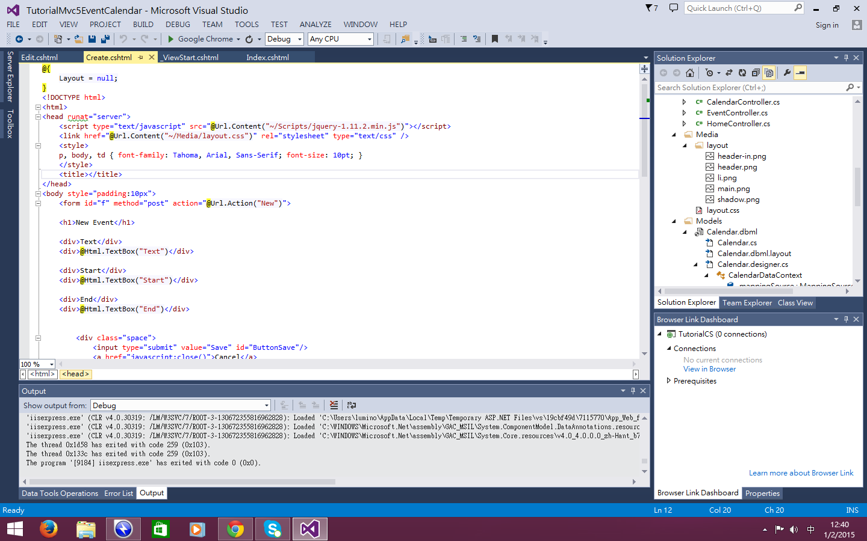
Explanation for how to work

Slide 6
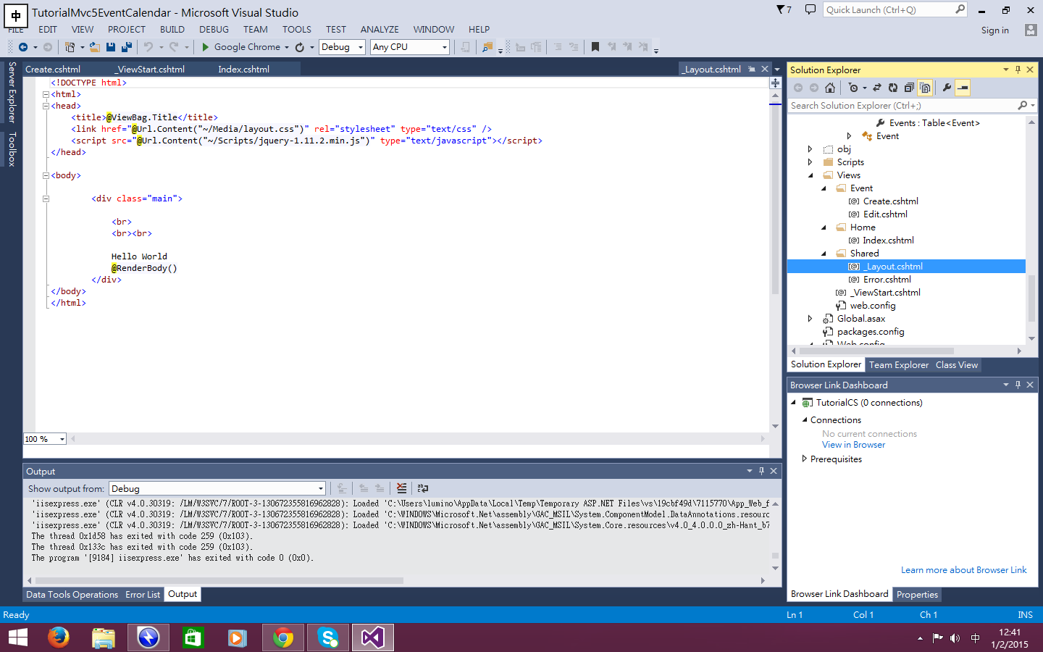

Slide 7
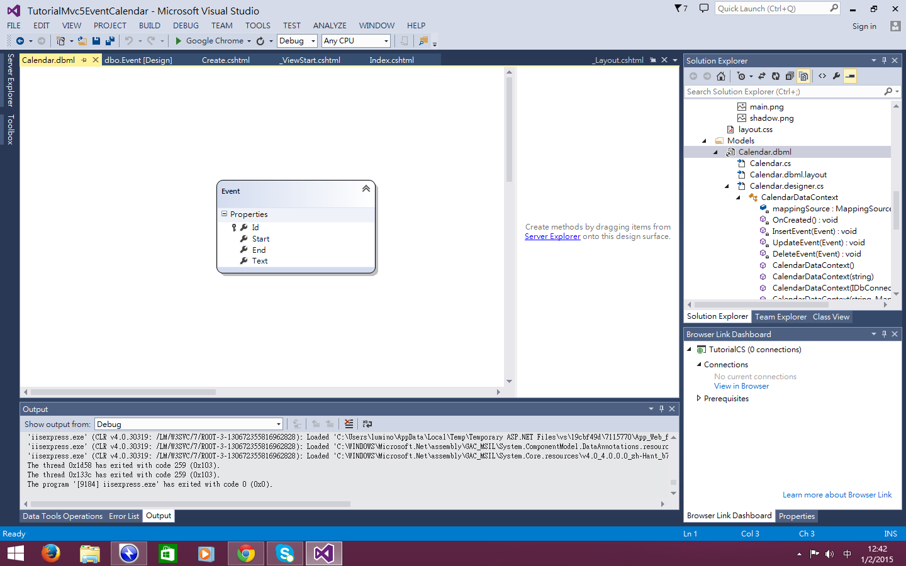

Slide 8
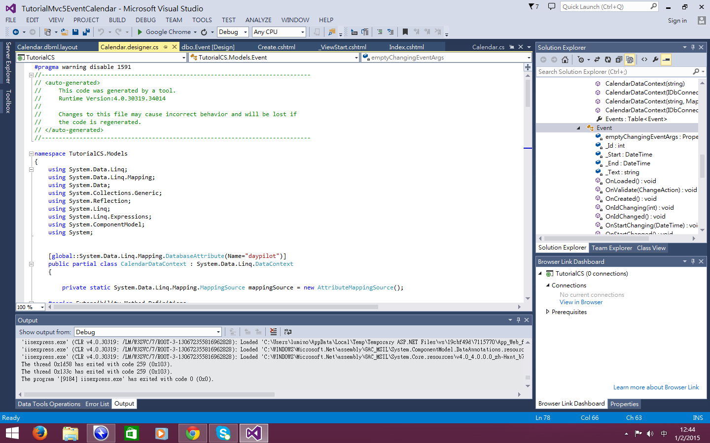

Slide 9
THE PROJ require database server
Case difference from past that saving docunment all saved in the file in so called “.mdf” file.
It ‘s common docunment used server for implement.
In the other word,Server Adminstrator required to open .mdf file by Window Server 2008/2012 ,then output SQL file for programming Adminstartor for implement the voice output function.
File position:TutorialCS\App_Data\Daypilot.mdf

Slide 10
Items for demo not enough
Therefore,both server and daabase admin should do sths for changed items values.
File should changed:
.dbml file in Model file
MDF Side
Layout Side

Slide 11
Limitation
->ASP.NET ‘s templates didn ‘t have any so called Friend Function(found almost 40 templates)
->However,it have a Restaurant and booking Function,which:
the users only view all users not selected users.
the users can changed the content of the other users(such like Google Drive)
Reference link:http://code.daypilot.org/34704/restaurant-table-reservation-tutorial-asp-net-c-vb-net

Slide 12
Situation Solution(may not efficient)
->Create each common link between friend and friend(即係每create一個friend就create一個新Page)
->假設朋友可以互改內容(好似Google Drive)

